Slide 1
Inheritance Session 7
Course : COMP 6175
Object Oriented Programming
Effective Period : October 2018

Slide 2
Outline
- Final Class and Method - Inheritance Example - Inheritance Introduction - Overloading VS Overriding - Subclass Feature - Super Keyword - Superclass and subclass

Slide 3
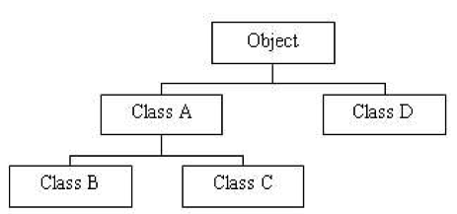
Inheritance
Inheritance can be defined as the process where one object acquires the properties of another with the most commonly used keyword would be extends and implements.
Inheritance allows to derive new classes from existing classes.

Slide 4
Inheritance Sketch
GeometricObject
SuperClass
Circle
Rectangle
SubClass
SubClass

Slide 5
Superclass and Subclass
Class that receive from other class, called a Subclass ( derived class, extended class or child class)
Superclass is also called as parent class
Subclass granted the right and pass to access the data members (fields / variables, methods, and nested classes) in the superclass.
Constructor is not a member so it is not inherited by subclasses
Allows adding new data member in a subclass

Slide 6
What you can do in a Subclass?
A Subclass bequeathed all rights to access both public and protected by its superclass, regardless of where the package from the subclass is located.
If a subclass have the same package with its superclass so the subclass will also get inheritance of package-private member from its superclass.
Use extends to access parent class
Not allowed to receive multiple inheritance from more than one parent class

Slide 7
Access Level
Still remember with the access modifier?
Private, protected, public, package
Modifier | Class | Package | Subclass | World
Public | Y | Y | Y | Y
Protected | Y | Y | Y | N
No-modifier (package-private) | Y | Y | N | N
private | Y | N | N | N
http://docs.oracle.com/javase/tutorial/java/javaOO/accesscontrol.html

Slide 8
Super keyword
Keyword this refer to objects in the class
Keyword super refer to superclass from its caller class
2 way of using keyword super :
Call superclass constructor
Example: super() or super( parameters )
Call superclass method
Example: super.method( parameters )
public void printRadius(){
System.out.println(“Radius of a circle is ” +
super.getRadius() );
}
Has been previously defined in superclass

Slide 9
Inheritance Code Example (1)
Parent Class (superclass) : Bicycle.java
public class Bicycle {
public int gear;
public int speed;
// constructor from class Bicycle with passing parameter
public Bicycle( int startSpeed, int startGear ) {
gear = startGear;
speed = startSpeed;
}
public void setGear ( int newValue ) {
gear = newValue;
}
public void applyBrake ( int decrement ) {
speed -= decrement;
}
public void speedUp ( int increment ) {
speed += increment;
}
}

Slide 10
Inheritance Code Example (2)
Child class(Subclass) : MountainBike.java
public class MountainBike extends Bicycle {
// Class MountainBike adding 1 field
public int seatHeight;
// Class MountainBike have 1 constructor
public MountainBike( int startHeight, int
startSpeed, int startGear ) {
super(startSpeed, startGear);
seatHeight = startHeight;
}
// Class MountainBike adding 1 function
public void setHeight ( int newValue ) {
seatHeight = newValue;
}
}
extends Bicycle = inheritance from class Bicycle

Slide 11
Advantage of Inheritance
Advantage in OOP : Reusability
When behaviour (method) is declared in super-class, that behaviour automatically inherited to all subclass
Could only encode method once and the method could be use by all subclass
A subclass only need to implement difference between itself with its parent

Slide 12
Overriding VS Overloading
Overriding :
Subclass modify method which has been defined by super-class
Function declared in subclass should have the same signature (name, amount and data type parameter) and return value method with that of in the super-class
Overloading :
More than one function having the same name with that of in super-class.
Function declared in subclass shouldn't have the same signature (name, amount and data type parameter) and return value method with that of in the super-class

Slide 13
Overriding Method
Example for Overriding
public class Animal{
public void print(){
System.out.println(“This is a method
from Class Animal");
}
}
Parent class
public class Duck extends Animal{
public void print(){
System.out.println(“This is class Duck");
}
public static void main(String [] args){
Animal objB = new Duck();
Animal objH = new Animal();
objH.print();
objB.print();
}
}
Print function overriding from print () function in
Its super-class. Have the same signature,
And also return value method

Slide 14
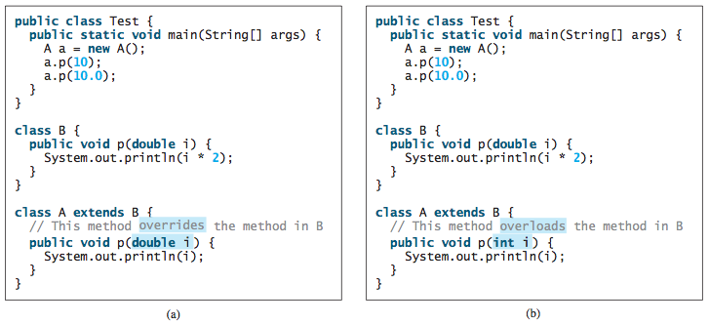
Overriding vs Overloading

Slide 15
Final Class
Final Class
Class that couldn’t be extends
To declare final class, we could write,
public final ClassName{ . . . }
Example: public final class Person {
. . .
}
Other example of final class is class wrapper and String.

Slide 16
Final Method
Final Method
Method that couldn’t be override
To declare final method, we could write,
public final return_Type method_Name ( parameters ){ . . . }
Example :
public final String getName(){
return name;
}
static method automatically is a final method.

Slide 17
Assignment
In this assignment you are required to make an application so called showroom using an implementation of inheritance.
Each cars type have their abilities.
Jeep : Capacity: 30; Speed:120
SUV : Capacity: 15; Speed: 100
Sedan : Capacity: 10; Speed 120;

Slide 18
Assignment
It has 3 menus:
Buy Once user choose this menu, then it will be asked to choose the car’s type (Jeep / SUV / Sedan) and the car’s name
Show This menu will show the list of car of each type
Exit Program end

Slide 19
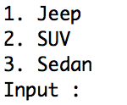
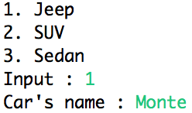
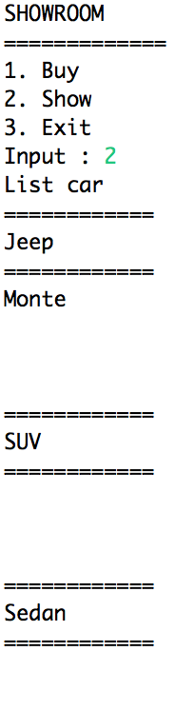
Assignment - Screenshots

Slide 20
References
Daniel Liang, Y., 2015, Introduction to java programming, vol.10, Pearson Education, New Jersey.
Access modifier:
http://docs.oracle.com/javase/tutorial/java/javaOO/accesscontrol.html
Inheritance and polymorphism
http://home.cogeco.ca/~ve3ll/jatutor5.htm
Learning Java Language - Inheritance
http://java.sun.com/docs/books/tutorial/java/IandI/subclasses.html
Overriding and Hiding Method
http://java.sun.com/docs/books/tutorial/java/IandI/override.html
Final Class
http://www.tech-faq.com/final-class.shtml
Final Method
http://www.tech-faq.com/final-method.shtml

